Slide 1
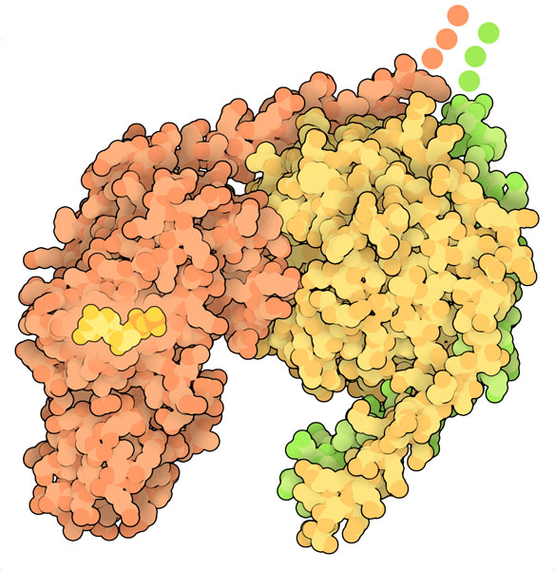
G PROTEINS
Laia Alcalà, Oriol Castellano, Aisha Shah, Júlia Salas

Slide 2
INDEX
INTRODUCTION
SEQUENCE ANALYSIS
STRUCTURE
FUNCTION
RASA1
EVOLUTIONARY HISTORY
SEQUENCE ALIGNMENTS
STRUCTURE ANALYSIS
MUTATIONS
SIMULATION
SECONDARY STRUCTURE
SUPERIMPOSITION
ACTIVE SITE
MUTATIONS AFFECTING WHOLE PROTEIN
MUTATION IN THE SH2 DOMAIN
MUTATIONS IN STRUCTURE
Wild Type
Mutant

Slide 3
G-Proteins function
INTRODUCTION
G-proteins are a family of receptors that play an important role in cell signaling
FUNCTIONS:
Signal transduction
Membrane vesicle transport
Cytoskeletal assembly
Cell growth
Protein synthesis

Slide 4
G-Proteins structure
INTRODUCTION
Heterotrimeric
𝝲
𝜶
𝜷

Slide 5
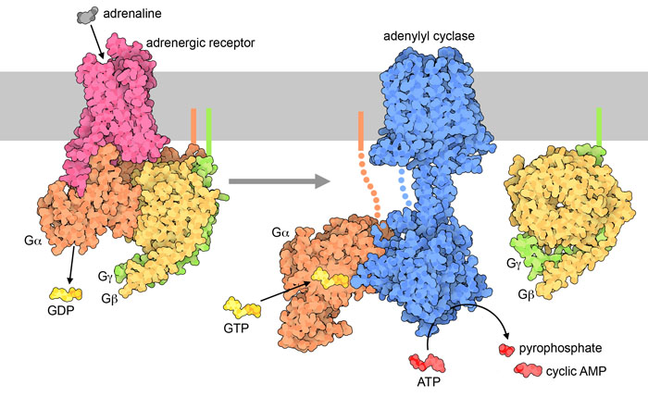
G-Proteins activation
INTRODUCTION
ACTIVE
BOUNDING
GTP
HYDROLYZATION
INACTIVE
BOUNDING
GDP

Slide 6
RASA 1
Ras GTPase-activating protein 1(GAP)

Slide 7
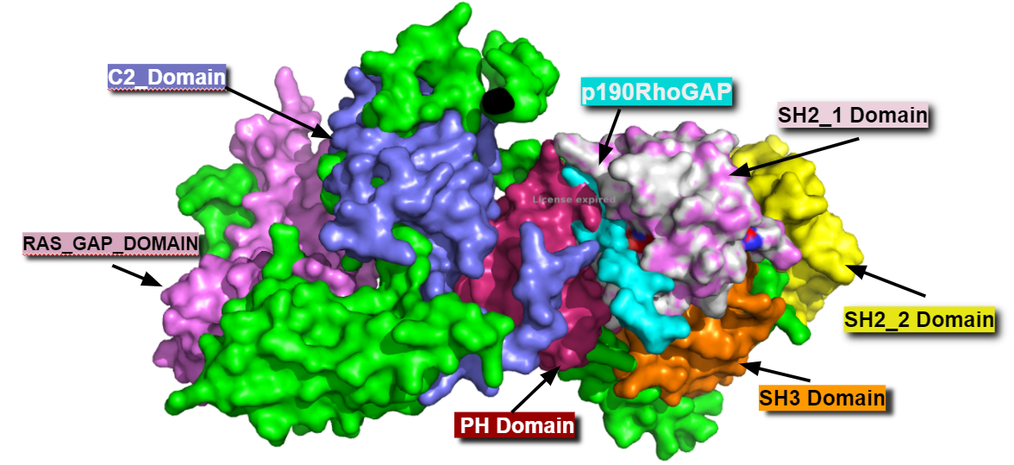
RASA1 Domains
INTRODUCTION
SH2 1
SH3
SH2 2
PH
C2
RasGAP
Protein-protein interaction
Btk motif
Phospholipids
Catalytic GAP domain
Binds with RAS protein which initiates RAS/MAPK pathway

Slide 8
RASA1-SH2 Function : Crosslinking of Rho-Ras Pathways
INTRODUCTION
Plasma membrane
Intracellular
GEFs
Ras-dependent pathway
Rasa1 activating Ras to start RAS/MAPK pathway and GAPs deactivating Ras to stop this pathway
Ras-GDP
Ras-GTP
GDP
GAPs
RAS pathway
Cell growth
Proliferation
Differentiation
GTP

Slide 9
RASA1-SH2 Function : Crosslinking of Rho-Ras Pathways
INTRODUCTION
Ras -independent pathway
Inhibits RAS and RHO pathways
PY1087
PY1105
GTPase
GTPase
RhoGAP
p190RhoGAP (ligand)
p120RasGAP (RASA1)
SH2
SH3
SH2
PH
C2
RasGAP

Slide 10
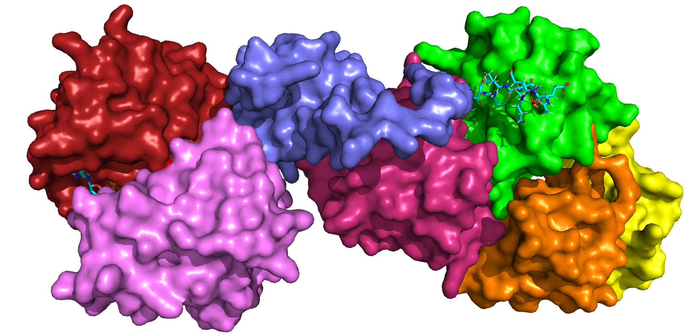
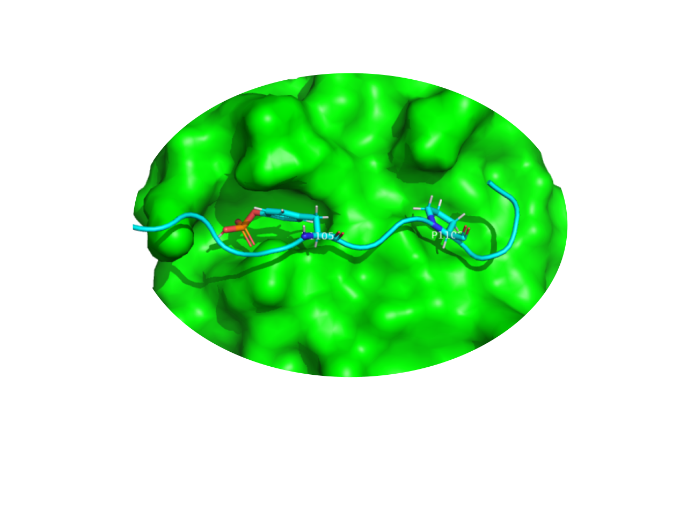
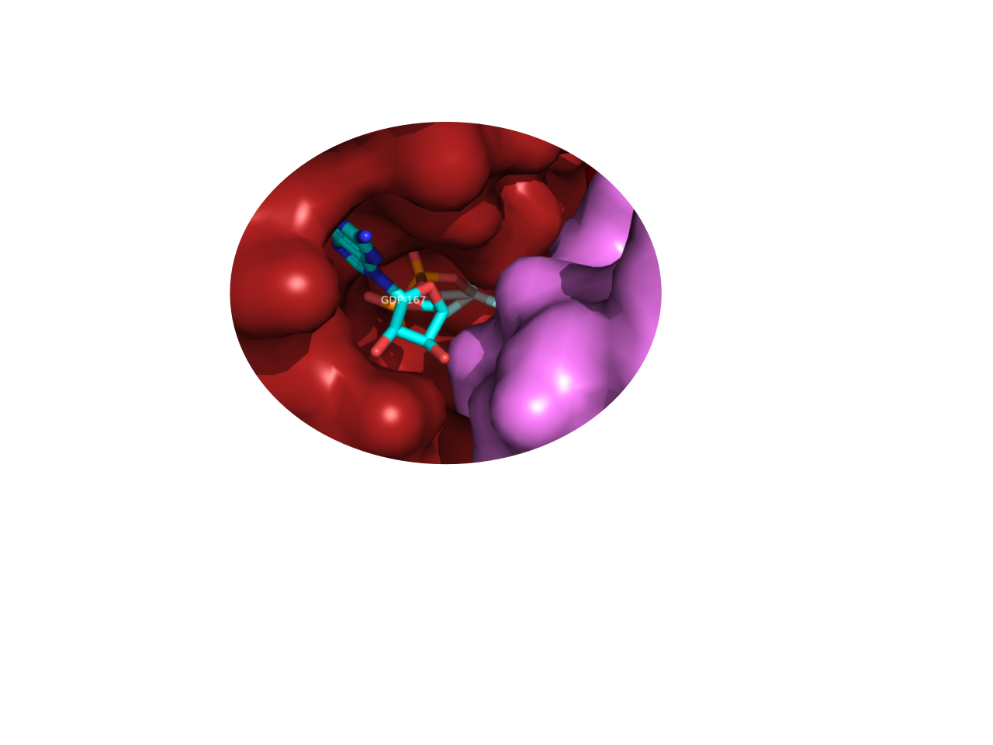
SH2
RAS-GTP
p190RhoGAP
RasGAP
RasGAP hydrolyzes RAS-GTP to RAS-GDP
Inactivation of RAS pathway
Increases activity of RasGAP and inhibits Rho pathway

Slide 11
Evolutionary history
SEQUENCE ANALYSIS
SH2 DOMAIN
To study the evolutionary history we have to work with similar sequences containing SH2 domain obtained using hmm search
HUMAN
P20936
BOVIN
P09851
MOUSE
E9PYG6
RAT
P50904
FRUIT FLY
Q9NHV9
CHICKEN
P00523

Slide 12
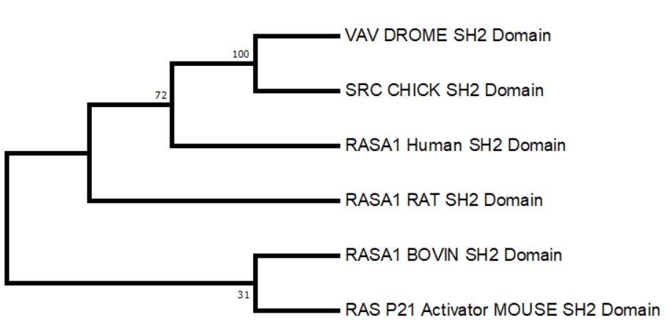
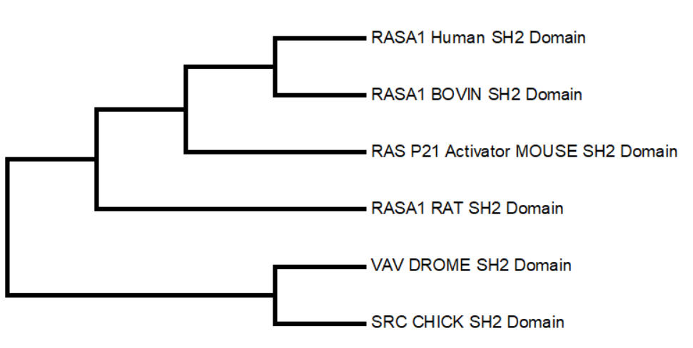
Evolutionary history
SEQUENCE ANALYSIS
Minimum
Evolution tree
Maximum Parsimony tree

Slide 13
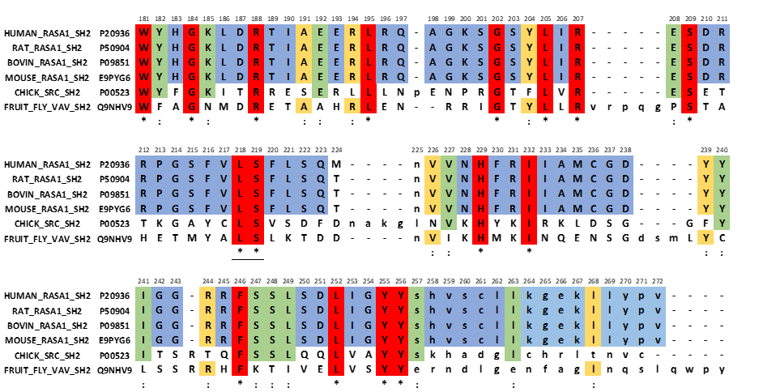
Sequence alignments and conserved regions
SEQUENCE ANALYSIS
MSA by Clustaw

Slide 14
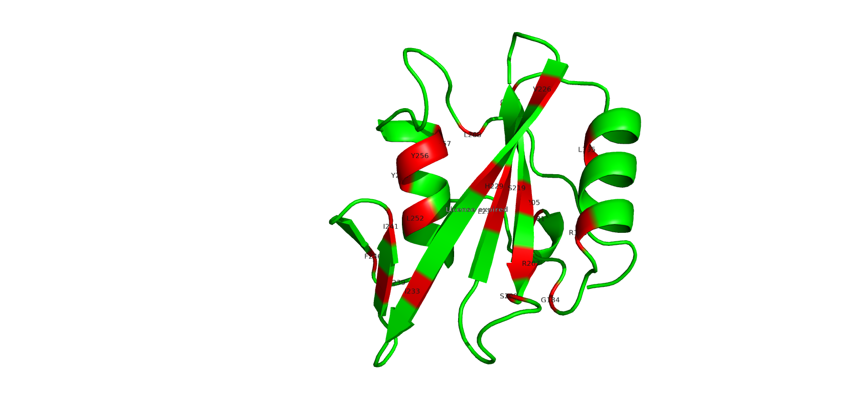
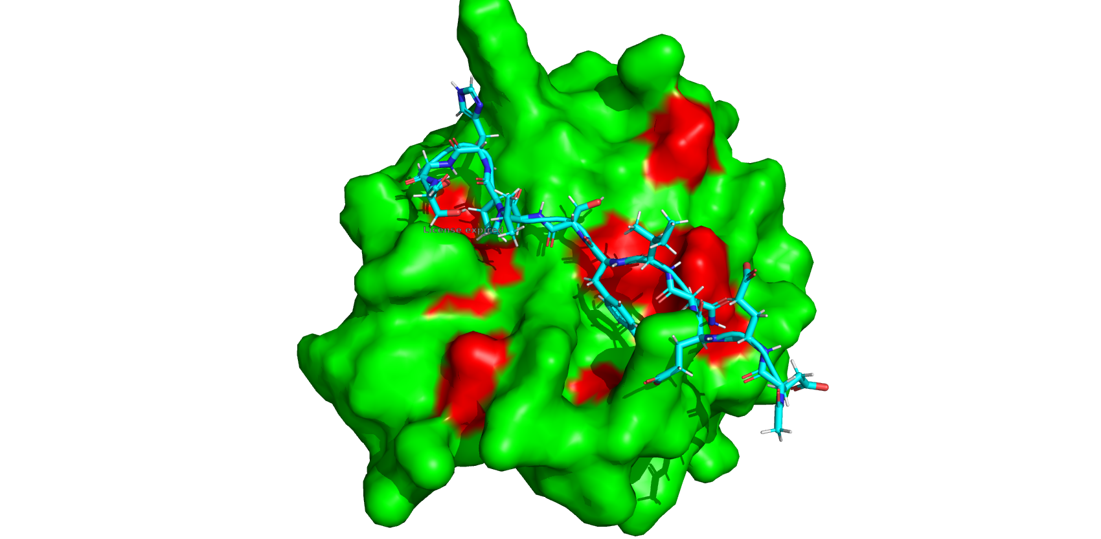
Conserved Regions
SEQUENCE ANALYSIS
Interacting with phosphotyrosine peptide
Stabilizing alpha helices and beta sheets
Mutations in these regions can affect the structure of the domain and binding of phosphotyrosine peptide

Slide 15
Structural Analysis

Slide 16
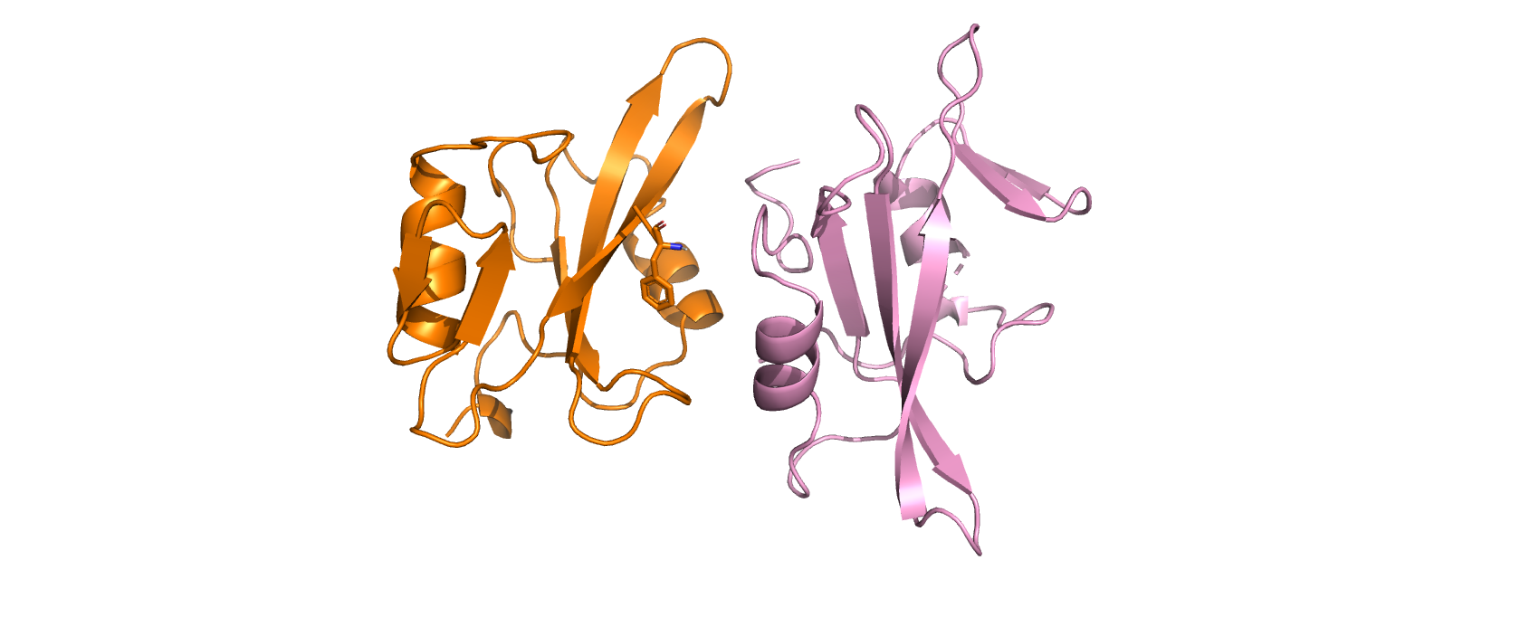
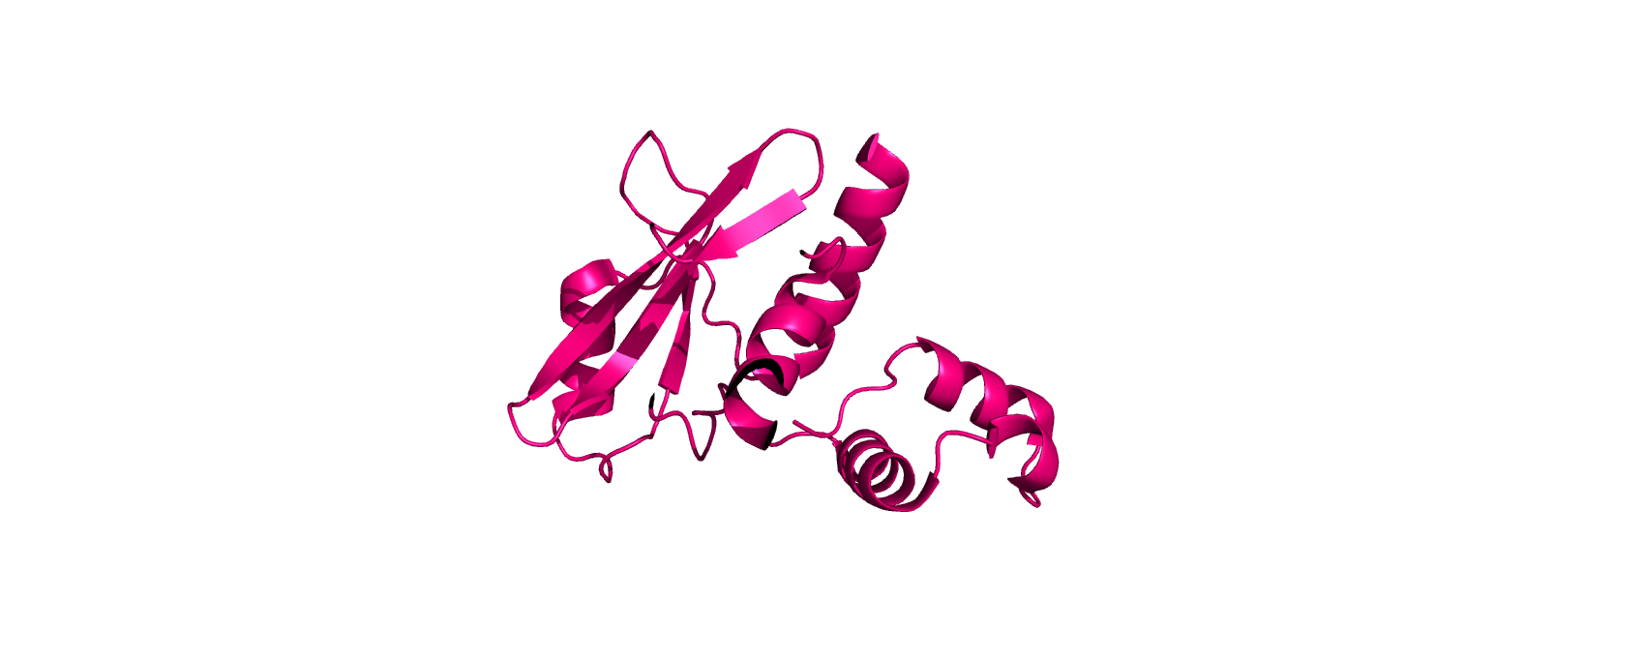
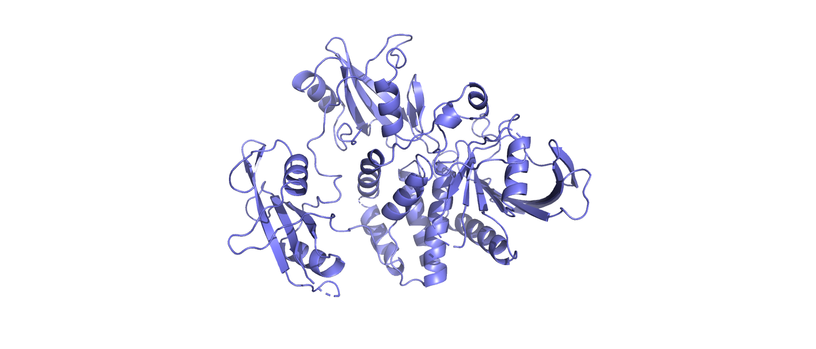
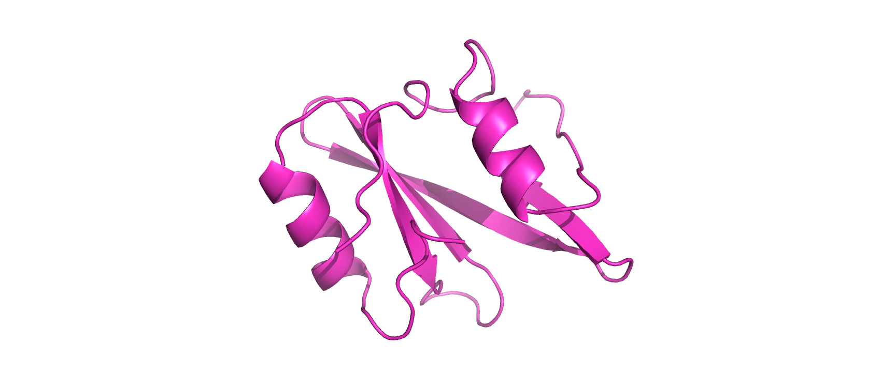
Secondary Structure
STRUCTURE ANALYSIS
PDB STRUCTURES
6pxc
To study the differences in secondary structure we have to obtain a set of structures in PDB. These structures belong to SH2 domains of different proteins not only RASA1.
2c9w_A
2shp_A
1d1z_A
1a07_A

Slide 17
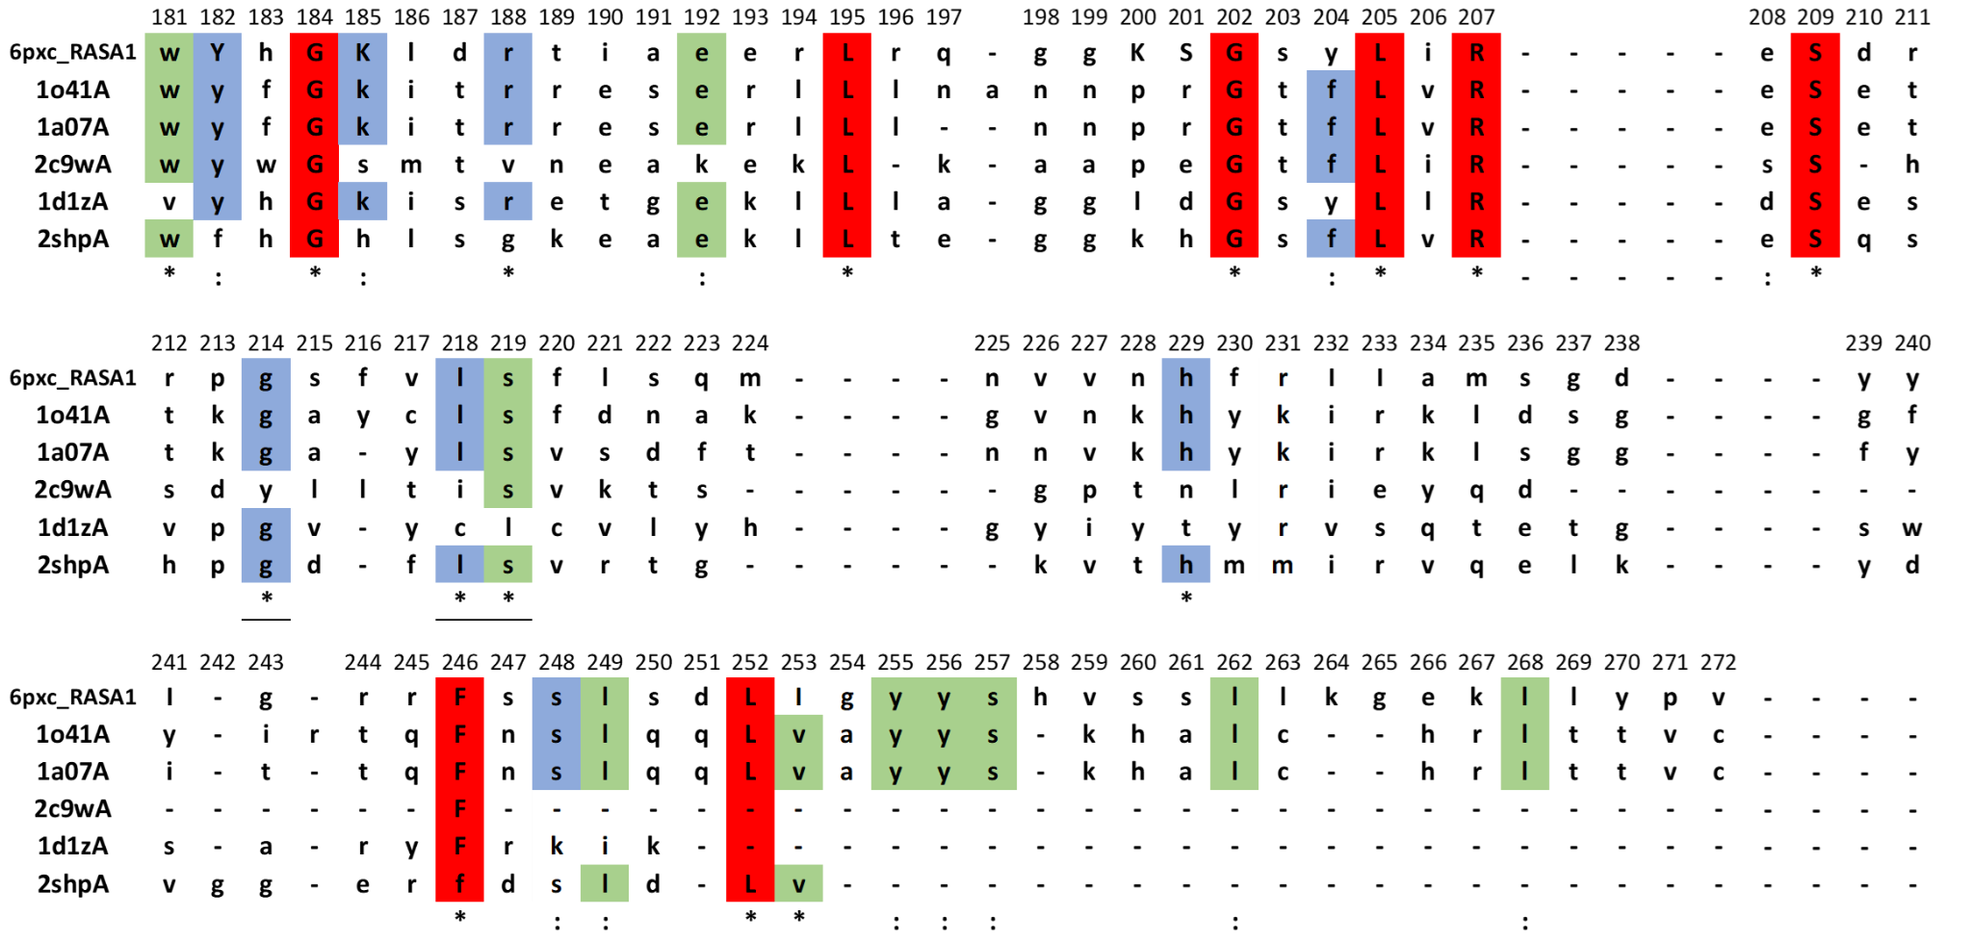
Clustalw alignment and Conservation
STRUCTURE ANALYSIS

Slide 18
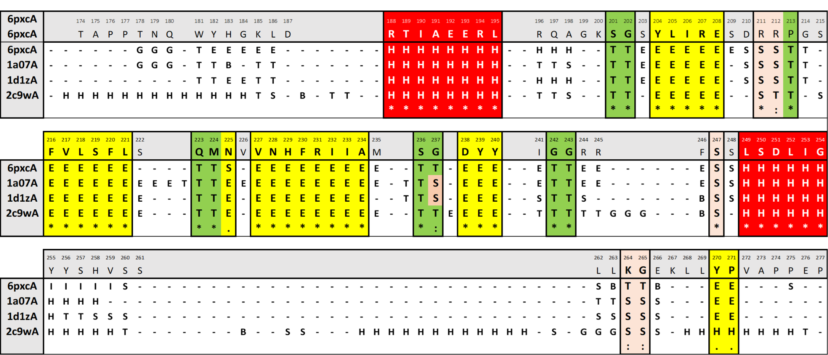
Secondary Structure
STRUCTURE ANALYSIS
Secondary structure alignment

Slide 19
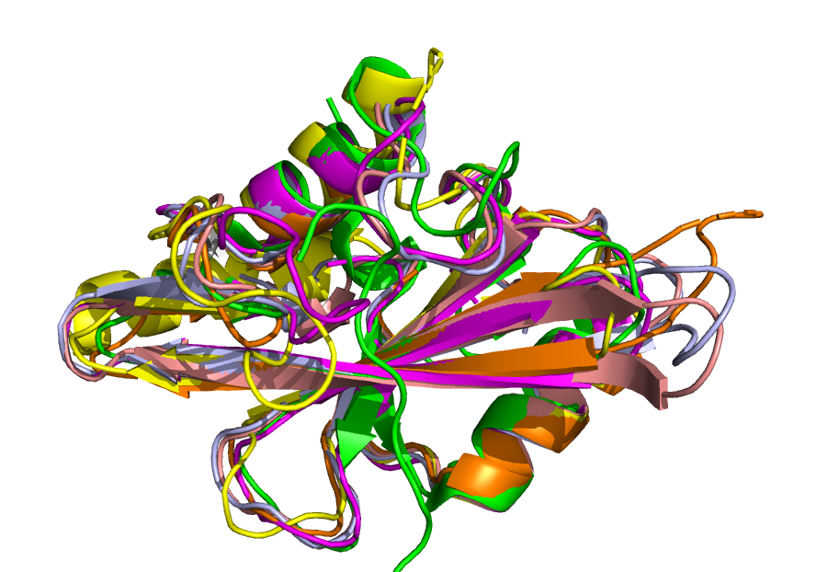
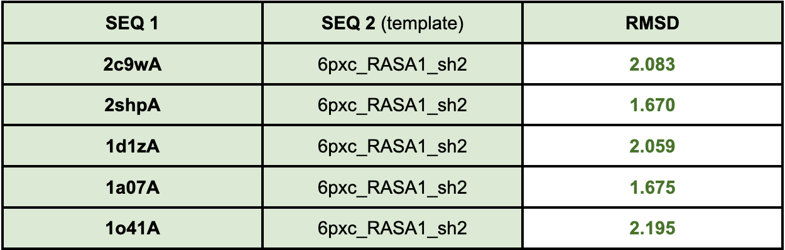
Superimposition
STRUCTURE ANALYSIS

Slide 20
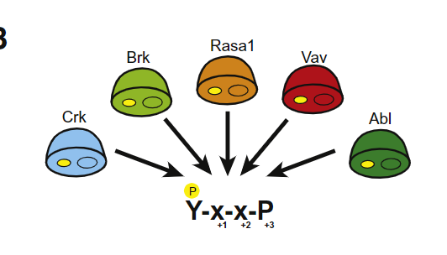
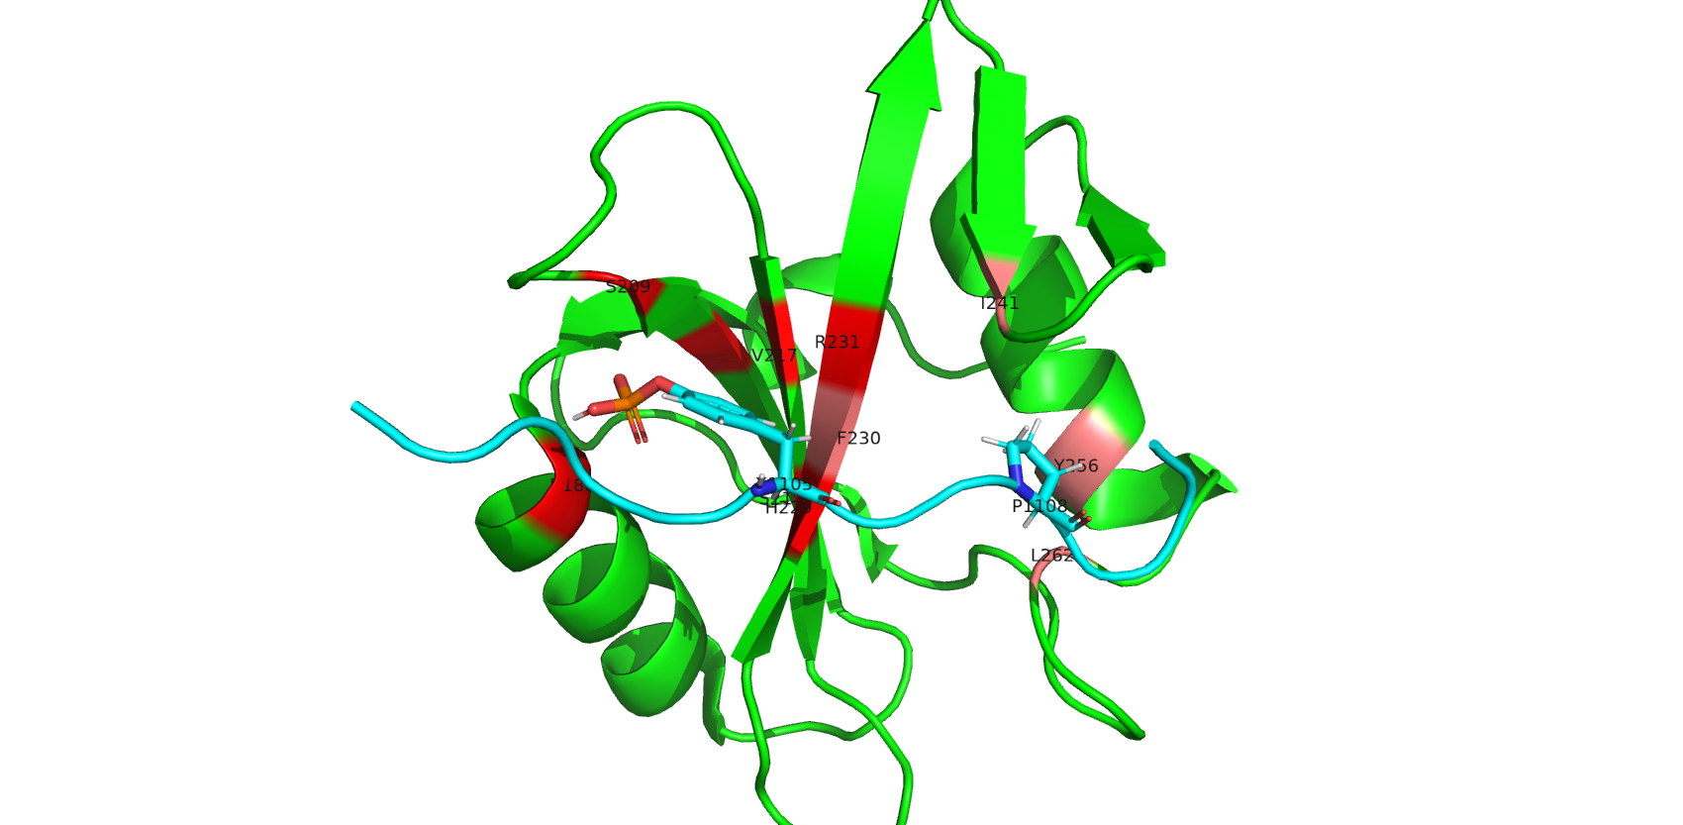
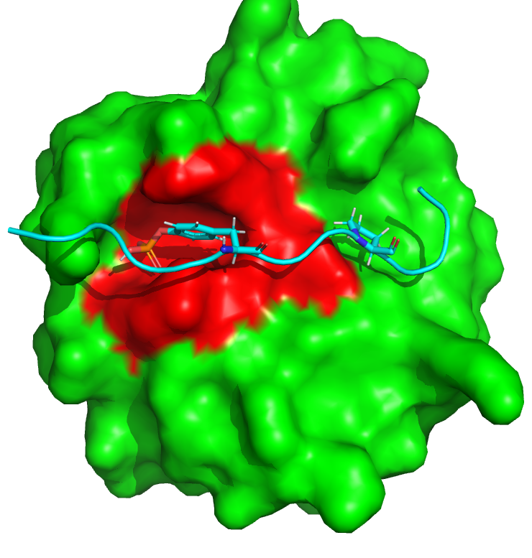
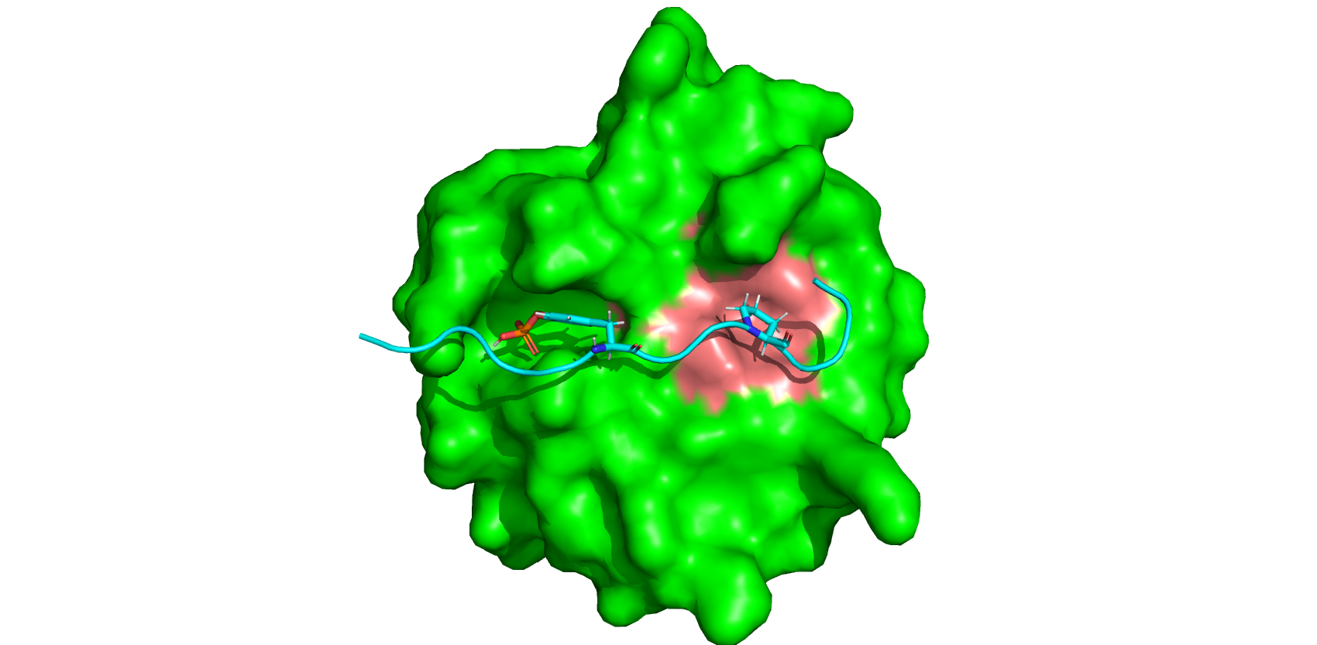
Active site for p190RhoGAP phosphotyrosine peptide binding
STRUCTURE ANALYSIS
+1
+2
pY
P
RASA1_SH2
RASA1_SH2
p190RhoGAP → XEEENI Y SV P HDST

Slide 21
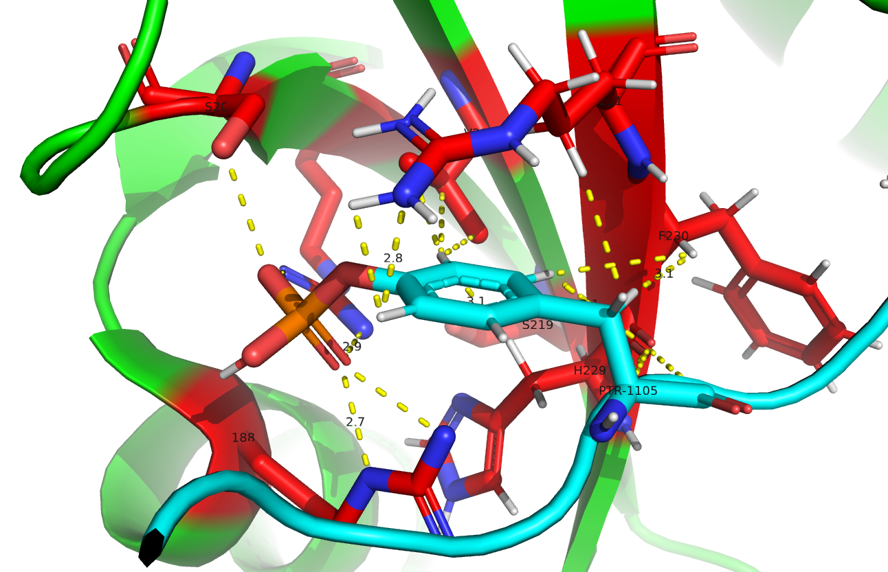
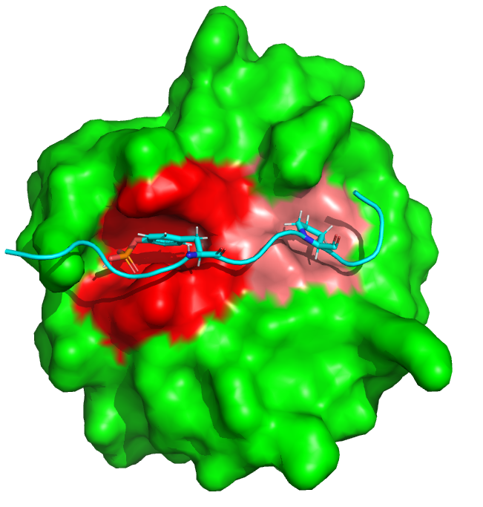
Active site: Binding Pocket for pY
STRUCTURE ANALYSIS
ARG207
ARG231
ARG188
Residues involved:
ARG 188, ARG 207, SER 209, HIS 229, ARG 231

Slide 22
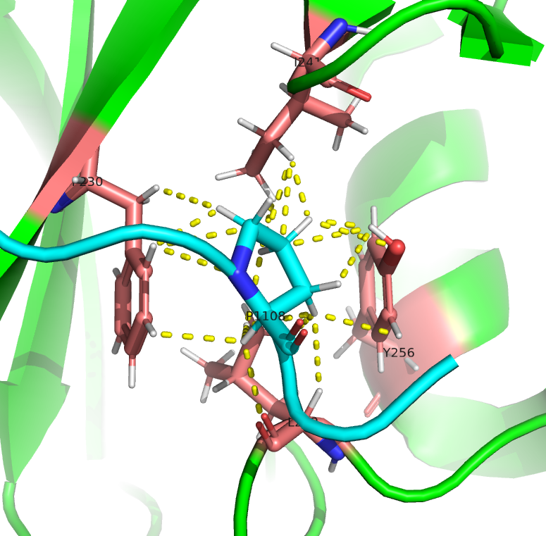
Active site : Binding Pocket for Proline
STRUCTURE ANALYSIS
Residues involved:
PHE 230, ILE 241, TYR 256, LEU 262

Slide 23
Modelling Mutations
Mutations found in Conserved regions of the sequences

Slide 24
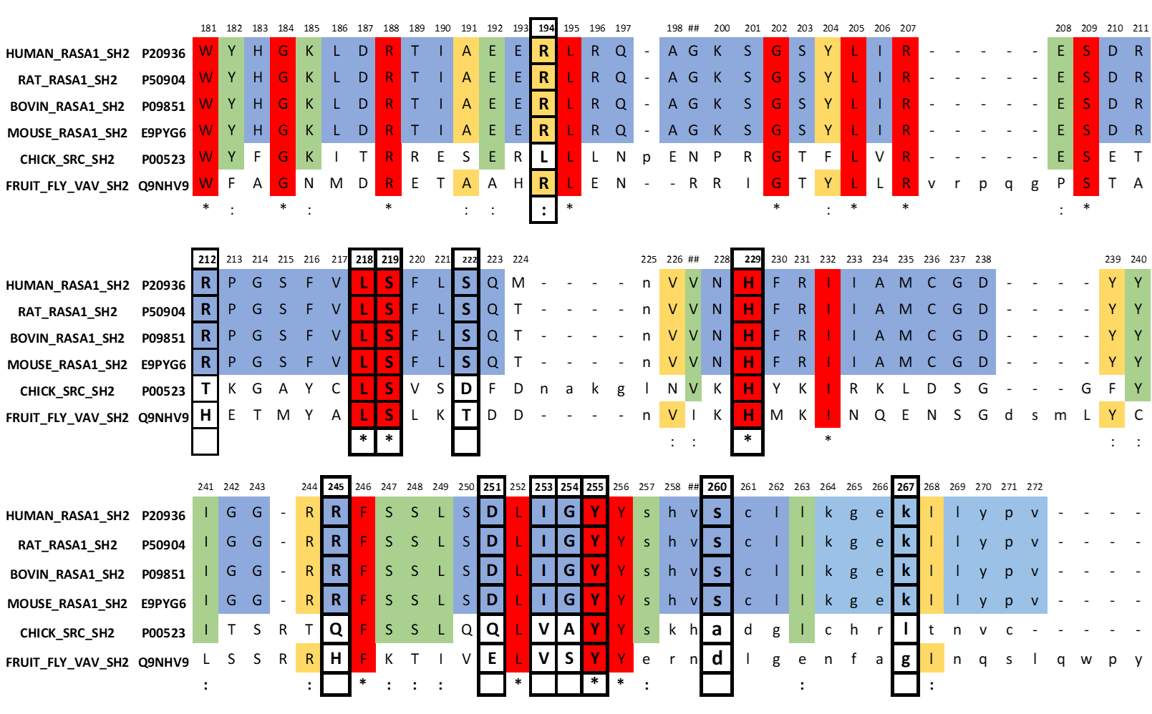
Mutations found in Conserved regions of the sequences
MUTATIONS

Slide 25
Mutations found in Conserved regions of the sequences
MUTATIONS
Mutations are highlighted in red

Slide 26
Effect of Mutations in RAS_GAP and SH2 domain
MUTATIONS
SH2
RAS-GTP
p190RhoGAP
RasGAP
RasGAP hydrolyzes RAS-GTP to RAS-GDP
Inactivation of RAS pathway
Increases activity of RasGAP
Inhibits rho and ras pathway

Slide 27
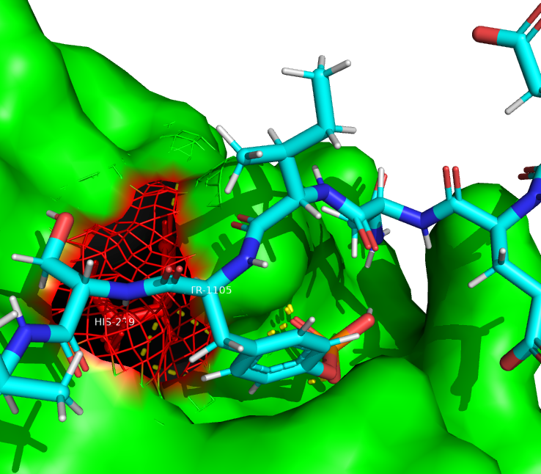
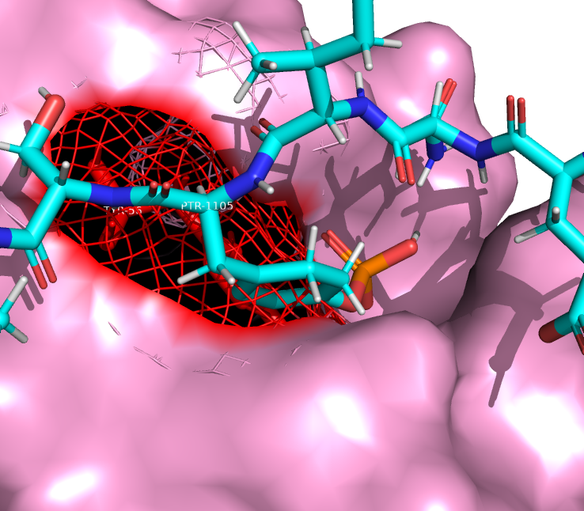
SH2 domain : Wild type vs mutant type
MUTATIONS
Position 229
Wild Type
Mutant
Reference residue: H
Alterated residue: Y
+1
+2
X
+1
+2
pY
pY
P
P
Nature
HIS | +
TYR | Polar Neutral
SH2
SH2
Prosa Z-scores
Template | -6.31
Pos 229 | -6.23
p190rhoGAP cannot bind
- Binding pocket for PTR of rhoGAP which is one of the two main residues that SH2 can recognize gets distorted.
- RAS pathway will not be inhibited from over activation
- uncontrolled cell proliferation
PTR
Notes:
This mutation is distorting the binding pocket for Tyrosine residue of rhoGAP

Slide 28
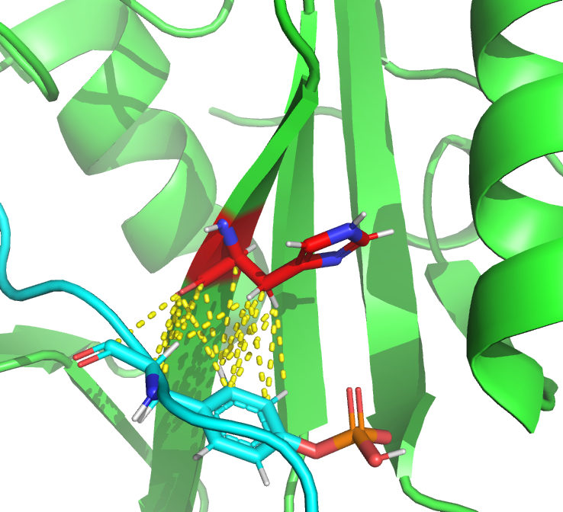
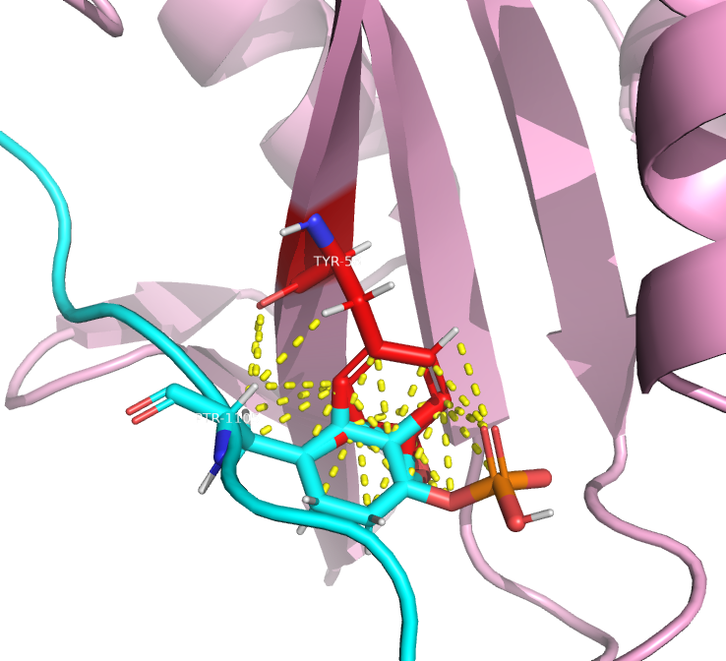
Wild type vs mutant type mutations
MUTATIONS
Wild Type
Mutant
Position 229
Reference residue: H
Alterated residue: Y
Nature
HIS | +
TYR | Polar Neutral
Prosa Z-scores
Template | -6.31
Pos 229 | -6.23
p190rhoGAP cannot bind
- RAS pathway will not be inhibited from over activation
- uncontrolled cell proliferation
Notes:
This mutation is distorting the binding pocket for Tyrosine residue of rhoGAP

Slide 29
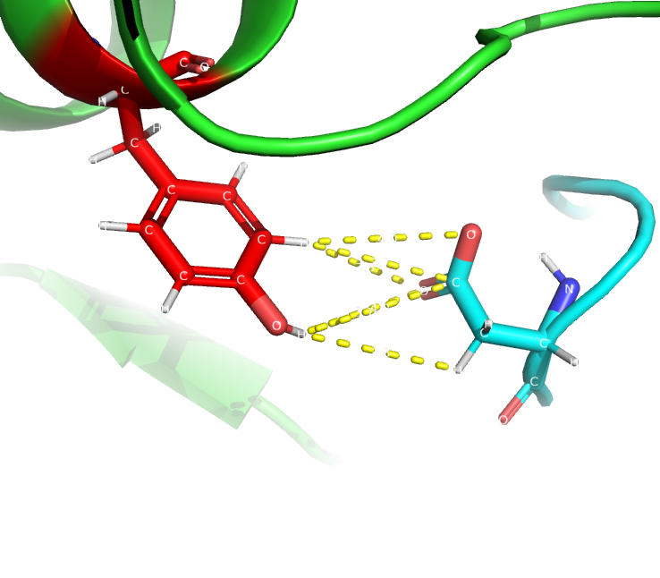
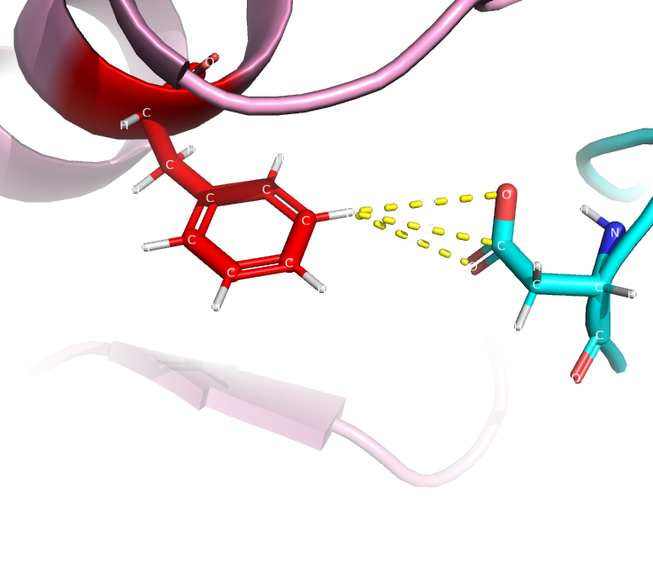
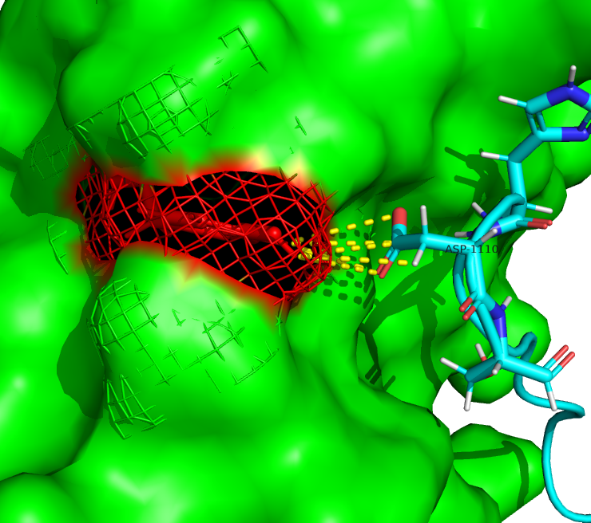
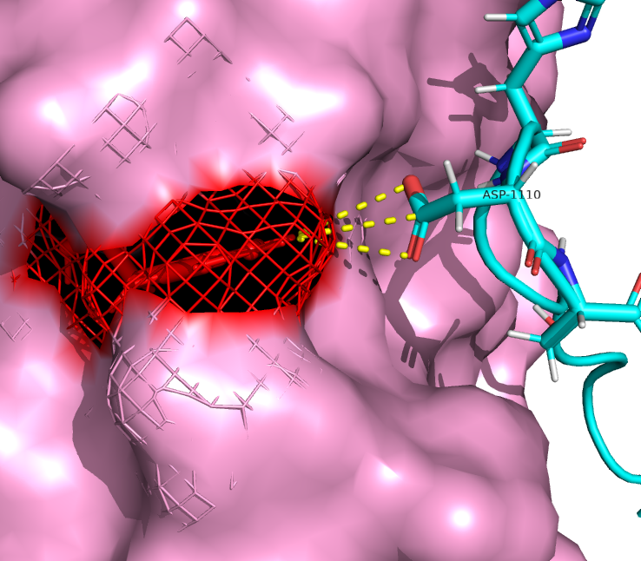
SH2 domain : Wild type vs mutant type
MUTATIONS
Position 225
Reference residue: Tyr
Alterated residue: Phe
Nature
TYR | Polar
PHE | Non-Polar
Prosa Z-scores
Template | -6.31
Pos 225 | -6.23
Loss of polar contacts with ligand at this position

Slide 30
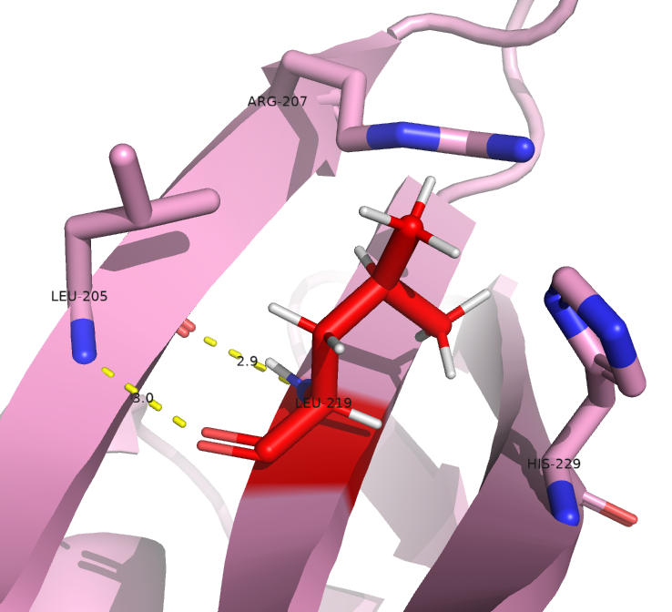
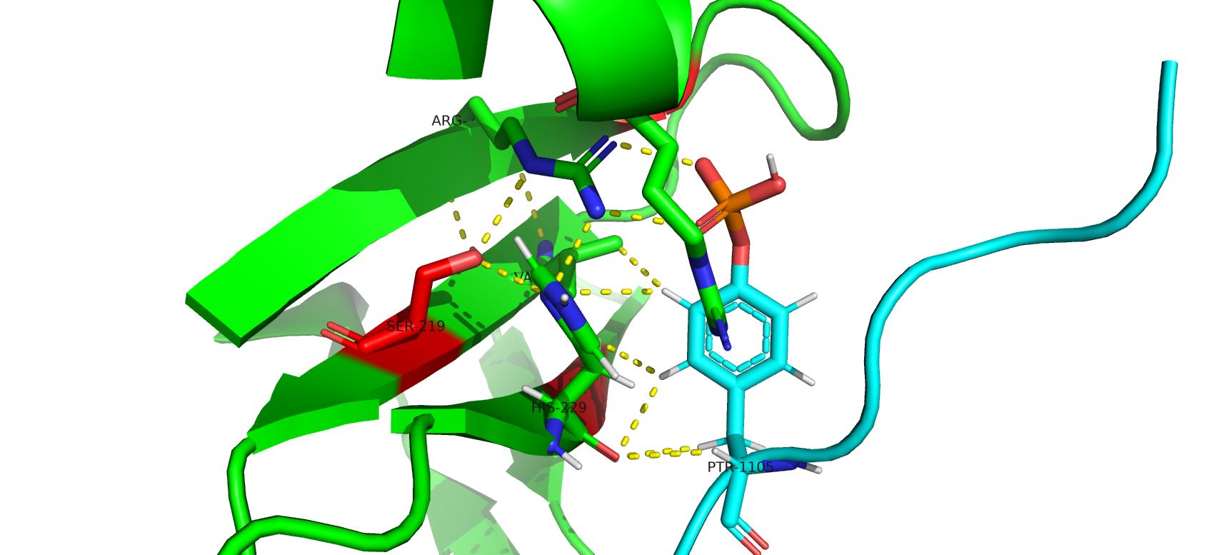
SH2 domain : Wild type vs Mutant
MUTATIONS
Position 219
Indirectly involved in Ligand binding.
Loss of polar interactions with nearby ARG(+) and HIS(+)
Nature
SER | Polar
LEU | Non-Polar
Prosa Z-scores
Template | -6.31
Pos 219 | -6.27
Reference residue: S
Alterated residue: L
R and H interacting with ligand

Slide 31
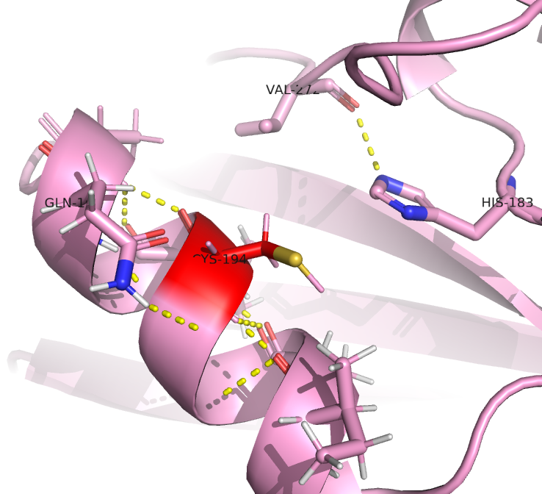
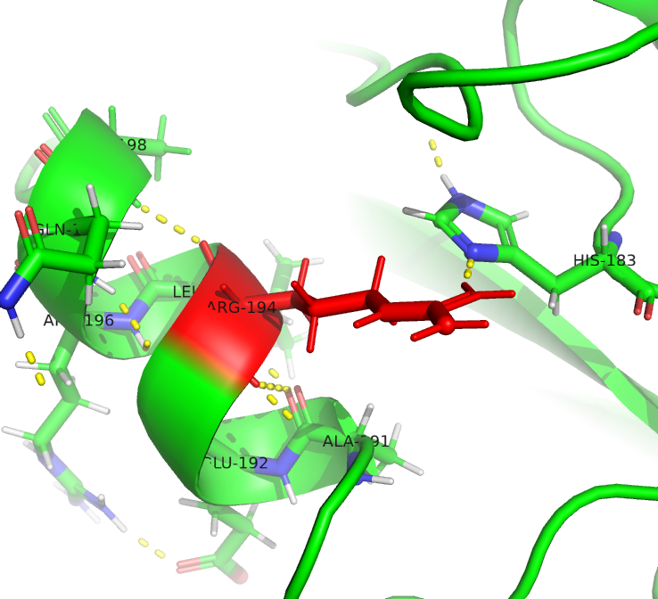
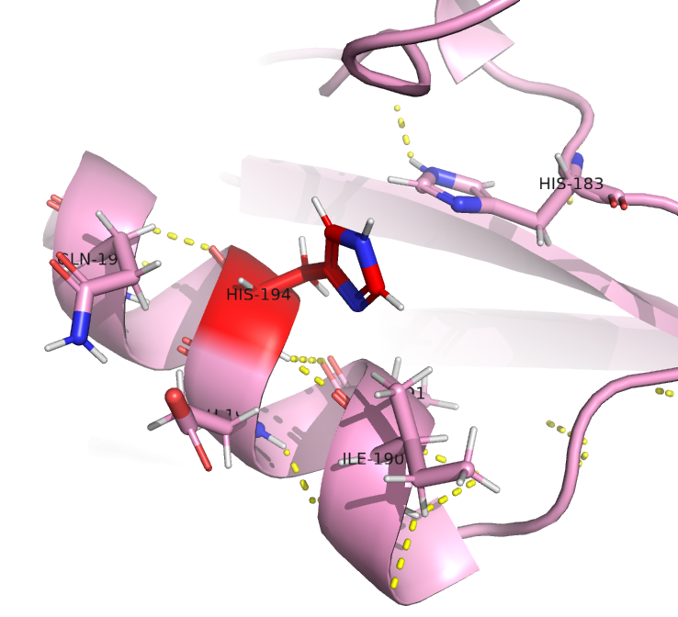
Wild type vs mutant type mutations
MUTATIONS
Position 194
Reference residue: R
Alterated residue: H/C
Nature
ARG | +
CYS | Non-Polar
HIS | +
Prosa Z-scores
Template | -6.31
H / C | -6.33 / -6.2
Loss of H-bond with ligand

Slide 32
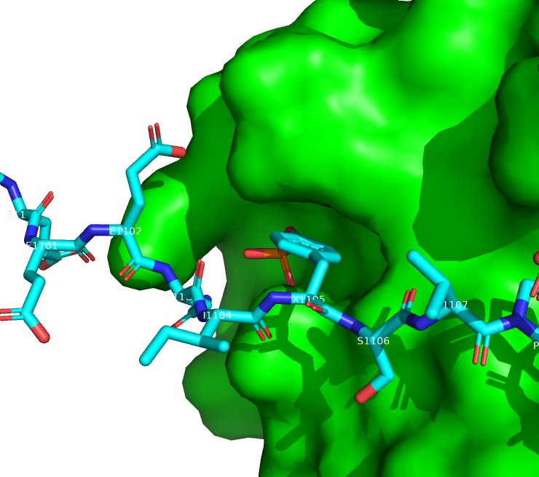
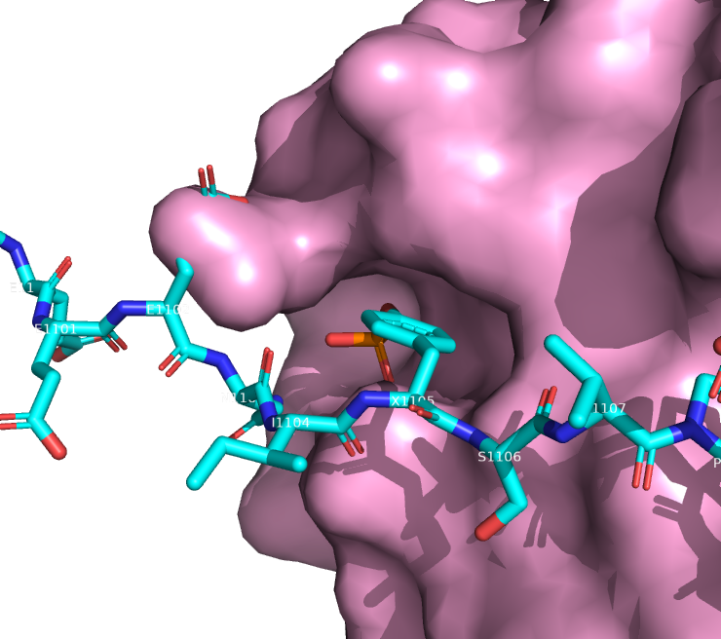
Wild Type VS Mutant Type Mutations → Causing Melanoma
MUTATIONS
Position 194, 218, 219, 222, 253 267
Wild Type
Mutant
Cancer type: Melanoma
Prosa Z-scores
template | -6.31
Melanoma | -6.16
Distortion of Binding Pocket
p190RhoGAp cannot bind
Overactivation of RAS pathway

Slide 33
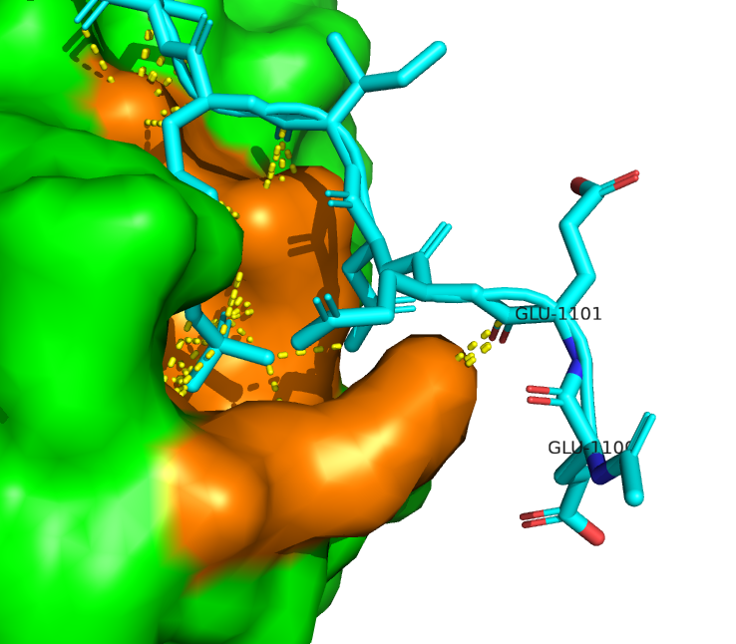
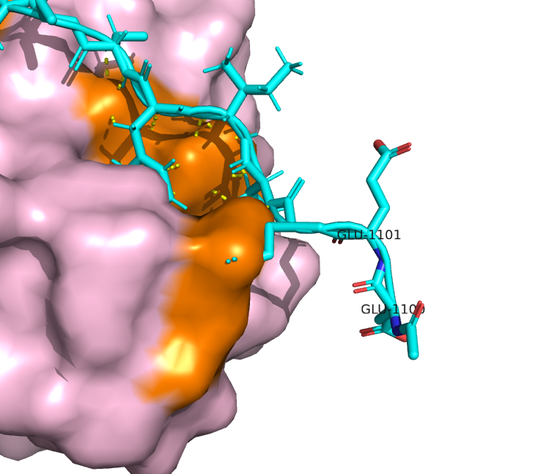
SH2 domain : Wild type vs mutant → Causing Breast Cancer
MUTATIONS
Position 245, 251, 255
Wild Type
Mutant
Cancer type: Breast cancer
 | Z-scores
Template | -6.31
Breast Cancer | -6.02
Distortion of Binding Pocket
p190RhoGAp cannot bind.
Overactivation of RAS pathway

Slide 34
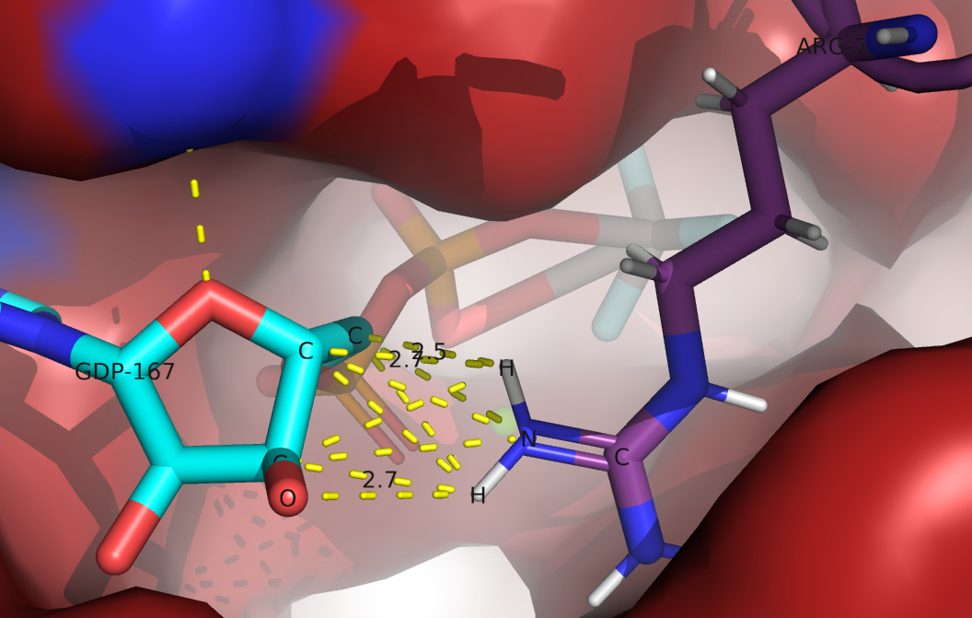
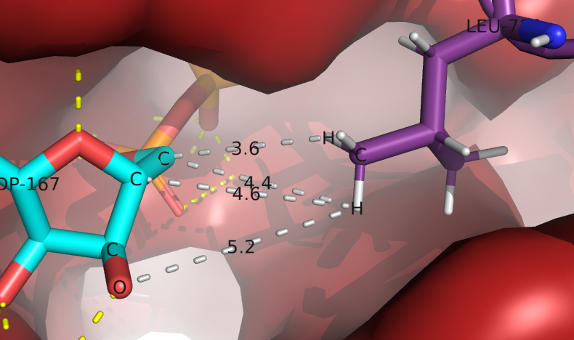
MUTATIONS
Mutation in the Ras_GAP domain causing overactivation of RAS pathway
Position 789
Loss of GTP binding Loss of RAS deactivation
SH2
RAS_GTP
Reference residue: Arg
Alterated residue: Leu
RAS_GAP

Slide 35
Molecular Dynamic Simulation

Slide 36
Energy Minimization , NVT and NPT equilibriation
Simulations

Slide 37
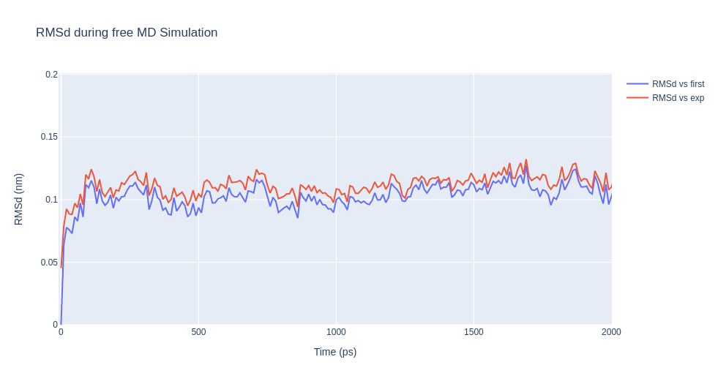
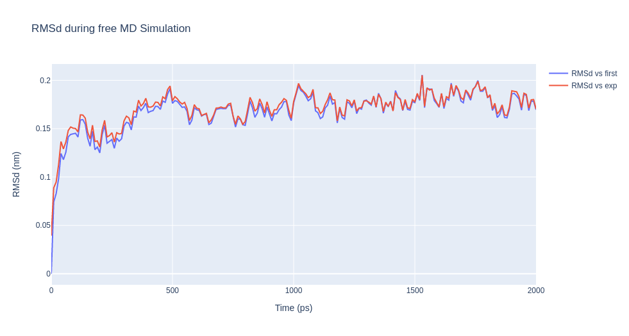
Simulation results of wild type and melanoma mutant
Simulations
Wild Type
Range : 0.09 - 0.13
Average : 0.1
Mutant
Range : 0.15 - 0.2
Average : 0.17
At each point RMSD of mutant is higher than that of Wild type
RMSD PLOT

Slide 38
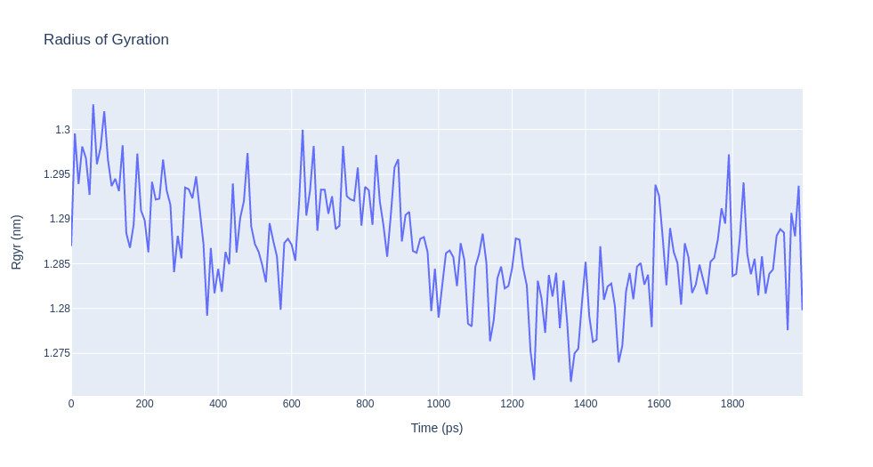
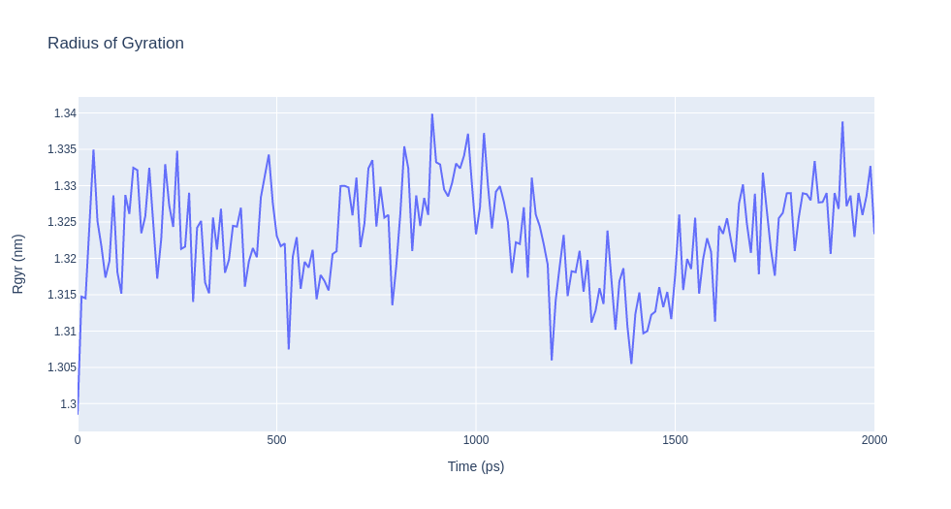
Simulation results of wild type and melanoma mutant
Simulations
Mutant
Range : 1.32 - 1.335
Wild Type
Range : 1.27 - 1.3
Radius of Gyration

Slide 39

Simulation of SH2 domain bound to a p190RhoGAP phosphotyrosine peptide (Wild Type)
Simulations

Slide 40

Simulation of SH2 domain bound to a p190RhoGAP phosphotyrosine peptide (Mutant Type)
Simulations

Slide 41
Alanine Scanning
Analysis

Slide 42
Statistical Analysis on geo dataset of gene expression
Analysis

Slide 43
Differential Gene expression
Analysis

Slide 44
Extra

Slide 45


G-Proteins interaction
INTRODUCTION
Ras GTPase-activating protein

